Slide 1
WebBootCaT usage 2010-2013
Adam Kilgarriff
Lexical Computing Ltd

Slide 2
History
BootCat publication 2004
Exciting but
  Classes of students with no unix skills
  permissions
  ☹
Sketch Engine: already running web service so
  2006: WebBootCaT
  All on our server
  load corpora into Sketch Engine
BootCaT Front End (2011?)

Slide 3
WBC usage 2010-2013
12,199 runs to build 8,832 corpora
  Ave: 1.38 iterations per corpus
  User selected keywords to iterate 673 times
Users:
  1131 people used it once
  1590 people: 2-10 times
  177 people: 11-50 times
  18 people: over 50 times
Sizes of corpora (in words)
  Still-existing corpora only
    Under 25k: 663
    25-100k: 945
    100k-1m: 889
    Over 1m: 33
NB
  a paying service
  default quota is 1m
    pay more for more

Slide 4
BootCaT Front End
Stats from Eros Zanchetta
 | Including Bologna | Excluding Bologna
Total number of known BootCaT installations (since August 5, 2011) | 3284 | 2165
Number of times each instance was used | Zipfian distribution | Zipfian distribution
BootCaT installations used at least once since January 1, 2013 | 858 | 712

Slide 5
Search engines
Achilles heel of BootCaT
WBC
  Was Yahoo
    Changes to API ☹
    Costs ☹
  2011 Change to Bing
    Free up to 5000 queries / month
    We make 3000-7000 /month
    We pay a few Euros a month for up to 10,000

Slide 6
How big a corpus do we get?

Slide 7
Observation
Specialist domain, L1
Specialist domain, L2
Matching terminology

Slide 8
Going multilingual
Translate seeds
  English: volcanology volcanologist "volcanic eruption" seismographs Eyjafjallajokull geodic "deformation monitoring" tephra magma stratigraphic tephrochronology geochronological "volcanic ash" ablation rhyolitic
  French:vulcanologue volcanologie "éruption volcanique" sismographes Eyjafjallajokull "surveillance de la déformation" géodiques tephra magma téphrochronologiestratigraphique géochronologiques "de cendres volcaniques" ablation rhyolitiques
BootCaT for English
BootCaT for French

Slide 9
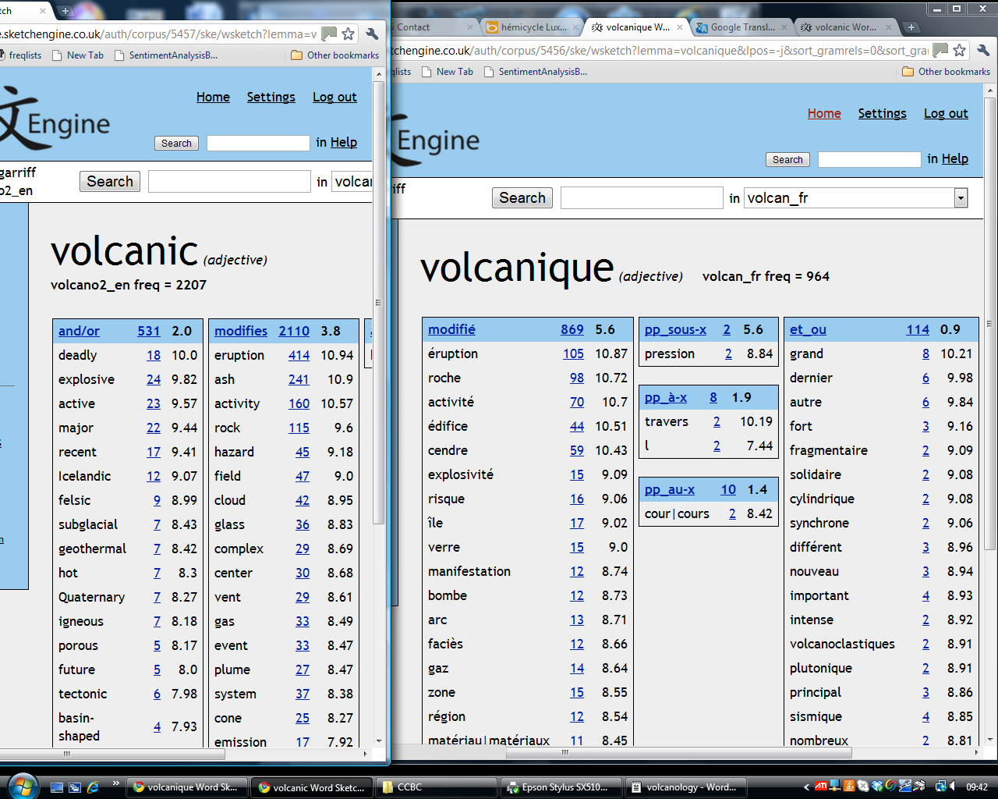

Slide 10
CCBC
Input: L1, L1 seeds, L2
Bilingual dictionary
Bootcat 2 corpora
Bilingual word sketches

Slide 11
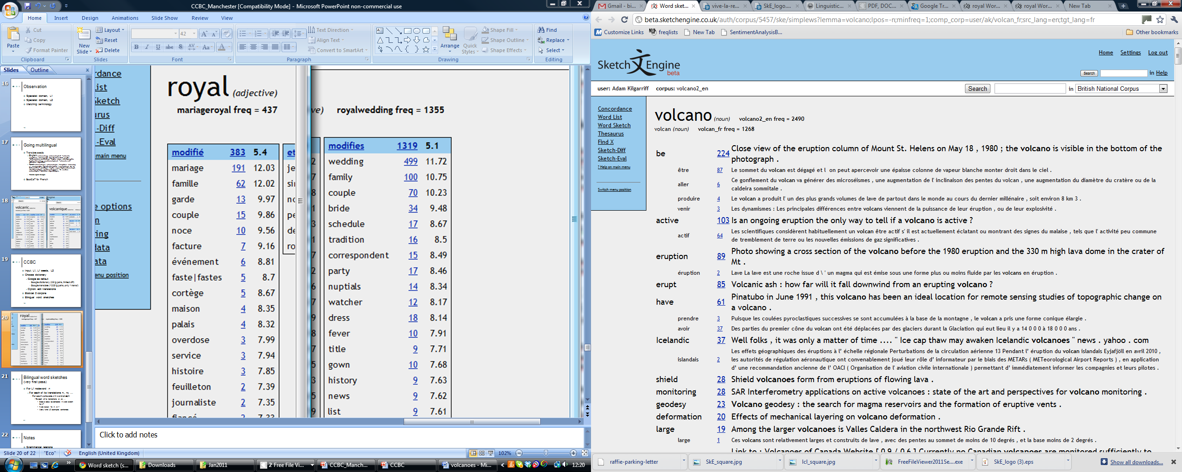

Slide 12
Matching seeds – how?
User translates
  Yes but limited
Bilingual dictionary
  Yes but finding them??
  Induced dictionary from EUROPARL
Wikipedia
  Matching articles
Measuring comparability
  Li and Gaussier, Serge

Slide 13
Corpus Architect
Part of SkE web service
Building/managing corpora
  WBC is one way of adding text
  Others
    Upload from your computer
    Point to specified URLs
    (recent request: whole site)
  One corpus can be multiple data sets
  Other services
    Cleaning, de-duping, lemmatising, tagging
    + explore in SkE

Slide 14
Survey
41 people
  Original command line 8
  Bologna Front End 16
  WebBootCaT 27
  Other 1
How often?
  Once a week or more 2
  Most months 7
  Occasionally 32
What for?
  Academic research 33
  Translation work 5
  Tr teaching/learning 8
  Lg teaching/learning 9
Size
  < 100 pages 13
  100-1000 (ca 1m wds) 18
  Bigger 11
Iterations etc
  Basic, defaults 8
  One round change params 15
  Iterations 22

Slide 15
Suggestions/comments
Some seeds wds: not possible to get corpus
Sources’ reliability needs to be improved
Less important now there is spiderling
Webinars please
Better support for languages/character-encoding
  Japanese, Greek
Apply over large static collection: replicablity

Slide 16
Suggestions/comments
Some seed wds: not possible to get corpus
Sources’ reliability needs to be improved
Less important now there is spiderling
Webinars please
Better support for languages/character-encoding
  Japanese, Greek (3/12 comments)
Apply over large static collection: replicability
More data with more relevant content please

