Slide 1
Polishing BootCat corpora: XML validation and tagset unification
Tomaž Erjavec
Dept. of Knowledge Technologies Jožef Stefan Institute
Ljubljana, Slovenia
BOTWU 2013

Slide 2
Overview
Introduction
Vertical format vs. XML
The SPOOK morphosyntactic specifications
Conclusions

Slide 3
Introduction
Made many (too many..) corpora, most are available at
http://nl.ijs.si/noske/ (NoSketchEngine)
http://nl.ijs.si/cuwi/ (CWB + CUWI front-end)

Slide 4
WaCs
jpWaC-L SRDANOVIĆ, Irena, ERJAVEC, Tomaž, KILGARRIFF, Adam. A web corpus and word sketches for Japanese. Shizen gengo shori, 2008, 15/2 HMELJAK SANGAWA, Kristina, ERJAVEC, Tomaž, KAWAMURA, Yoshiko. Automated collection of Japanese word usage examples from a parallel and a monolingual corpus. Proceedings of eLex 2009
hrWaC, slWaC LJUBEŠIĆ, Nikola, ERJAVEC, Tomaž. hrWac and slWac : compiling web corpora for Croatian and Slovene. LNCS, 2011, vol. 9743
SPOOK corpora (sl, de, it, fr, uk) ERJAVEC, Tomaž. Vzporedni korpus SPOOK : označevanje, zapis in iskanje terminoloških virov. In VINTAR, Špela (ed.). Slovenski prevodi skozi korpusno prizmo, (Zbirka Prevodoslovje in uporabno jezikoslovje). Znanstvena založba Filozofske fakultete, 2013 → deWaC, itWaC, frWaC, :(ukWaC)

Slide 5
Problems
Source corpora often contain „formatting“ errors
With multilingual corpora different tagsets are user unfriendly

Slide 6
I. Cleaning WaC corpora
CWB vertical format:
<text url="http://www.epguides.de/nikita.htm">
<s>
Nikita Nikita NE
( ( $(
La La FM
Femme Femme NN
Nikita Nikita NE
) ) $(
Dieser dies PDS
…
What to do if the data has bugs?
some are found in the process of (CWB, noSkE) corpus compilation
but many aren‘t, esp. related to character sets:
bad characters in text
bad escapes of special chars (e.g. quotes in struct. attributes)
etc.
a solution: convert vertical file to „vertical XML“

Slide 7
Fixing vertical files
Performed the following on deWaC, itWaC, frWaC, ukWaC (and in preprocessing of hrWaC, slWaC, jpWaC-L):
(uniform filenames)
convert to utf-8
remove Ctrl characters
do other char magic (e.g. non-break space „token“ to nothing)
escape special XML chars (&amp; &lt; &gt; &quote; &apos;)
give root <corpus> element with @xml:id and @xml:lang
Add „domain“ to text element
Insert <g/>

Slide 8
Output
<corpus xml:id="deWaC" xml:lang="de">
<text url="http://www.epguides.de/nikita.htm" domain="epguides.de">
<s>
Nikita Nikita NE
( ( $(
<g/>
La La FM
Femme Femme NN
Nikita Nikita NE
<g/>
) ) $(
Dieser dies PDS

Slide 9
II. Harmonising tagsets
SPOOK project, similar to Czech InterCorp
Compiled corpora of novels for: de-sl, en-sl, fr-sl, it-sl, sl
500k – 1M words per language
Available via concordancer, but only to project members
Corpora have been tokenised, tagged, lemmatised
For Slovene: ToTaLe
For other languages: TreeTagger

Slide 10
MULTEXT-East
For Slovene we use the JOS tagset
JOS tagset is identical to MULTEXT-East V4 for Slovene, c.f. http://nl.ijs.si/ME/V4/
MULTEXT-East specifications cover Bulgarian, Croatian, Czech, English, Estonian, Hungarian, Lithuanian, Macedonian, Persian, Polish, Resian, Romanian, Russian, Serbian, Slovak, Slovene, Ukrainian
Written in TEI P5
Define Parts-of-Speech, their attributes & their values
Map feature-structures to MSDs (tags)

Slide 11
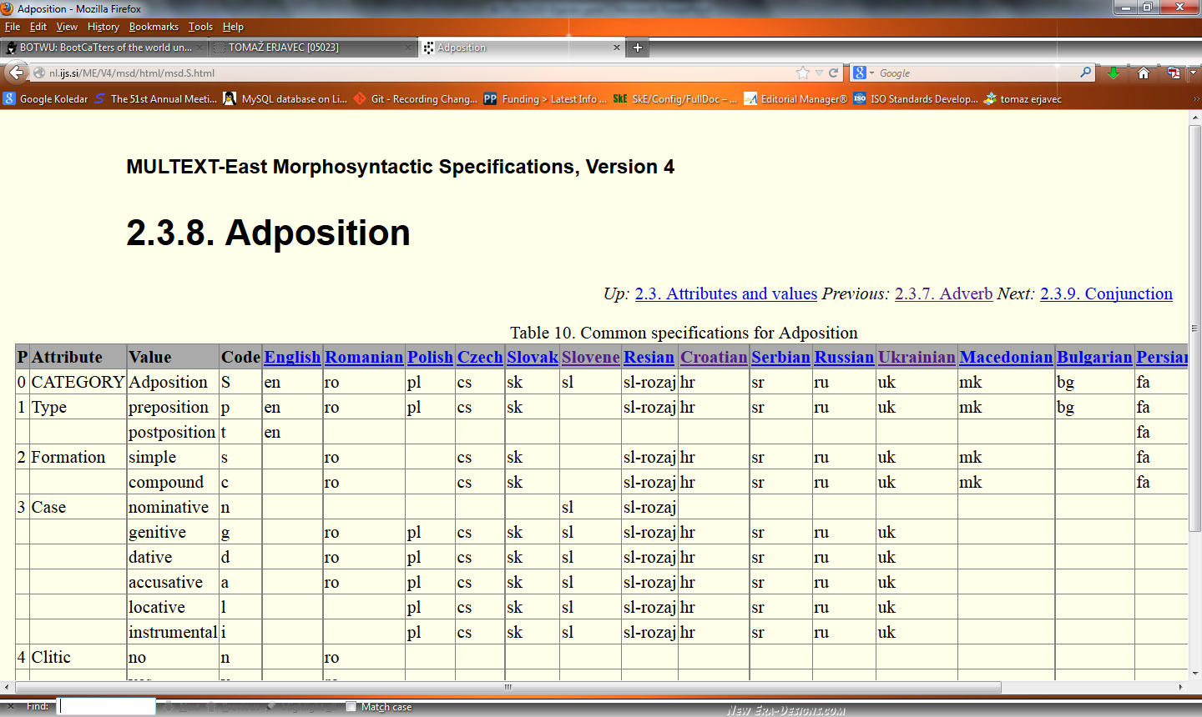
Common tables

Slide 12
Language particular tables

Slide 13
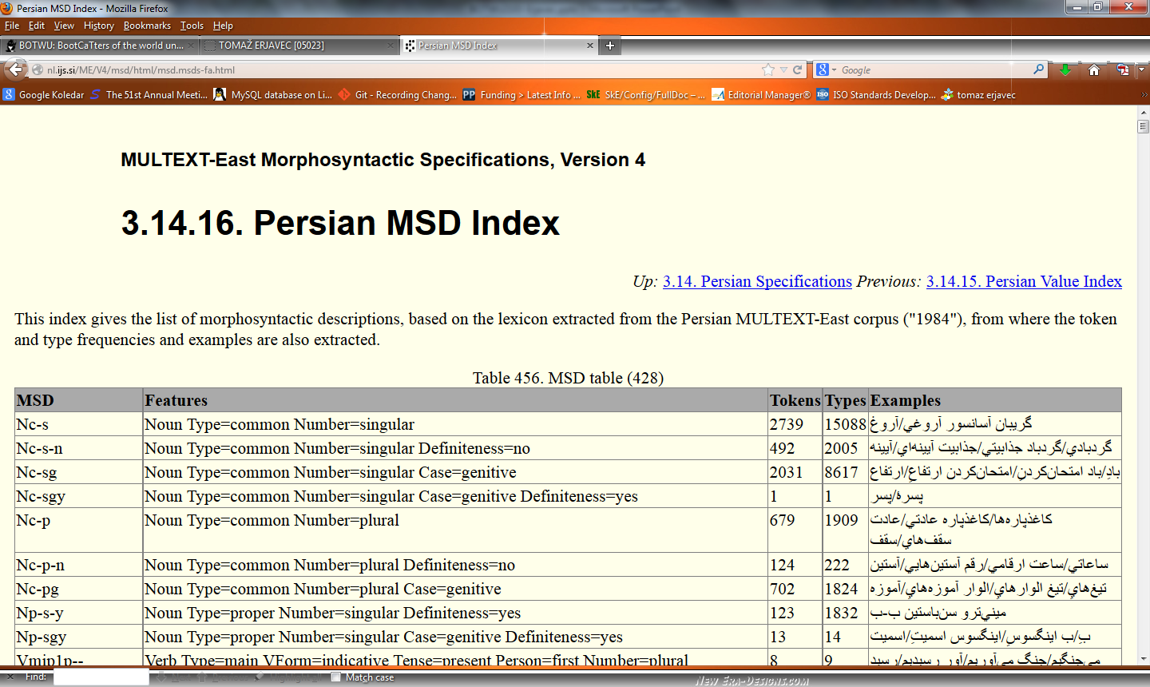
MSD tagsets

Slide 14
TreeTagger
Very popular, as it comes with ready language models
We used it to tag and lemmatise SPOOK (foreign) corpora
But tagsets for various languages are very different:
English: Noun Type=common Number=singular = NN
German: Noun Type=common = NN
French: Noun Type=common = NOM
Italian: Noun Type=common = NOUN
Makes it difficult to use such multilingual corpora

Slide 15
Harmonising tagsets
By now quite a few suggestions:
Minimalistic (looses information): Slav Petrov, Dipanjan Das, Ryan McDonald (2011): A universal part-of-speech tagset, ACL 2011
Maximalistic (complex to develop): Alexandr Rosen (2010): Mediating between Incompatible Tagsets. Proceedings of the Workshop on Annotation and Exploitation of Parallel Corpora AEPC 2010
Medium (no loss if information, relatively simple): SPOOK morphosyntactic specifications (2012) http://nl.ijs.si/spook/

Slide 16
SPOOK specifications
Approach based on MULTEXT-East
Currently covers de, en, it, fr, (sl)
Gives features and tags for these languages
Names in English and Slovene
Defines a 1-1 mapping from TreeTagger tags to SPOOK tags
Features chosen so that they allow for such a mapping
No attempt at „deep“ unification

Slide 17
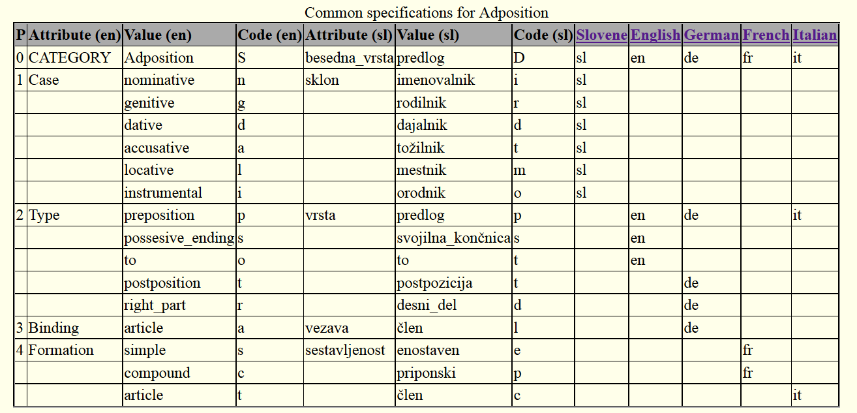
Common tables

Slide 18
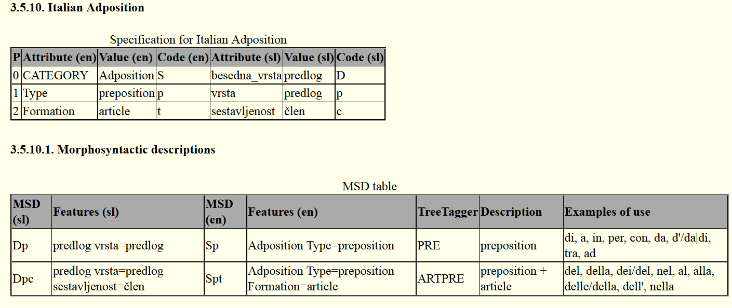
Language particulars

Slide 19
Applying to WaCs
<corpus xml:id="deWaC" xml:lang="de">
<text url="http://www.epguides.de/nikita.htm" domain="epguides.de">
<s>
Nikita Nikita NE Np Sl
( ( $( ( (
<g/>
La La FM Xf Nj
Femme Femme NN Nc So
Nikita Nikita NE Np Sl
<g/>
) ) $( ( (
Dieser dies PDS Pds Zks
Episodenführer Episodenführer NN Nc So
wurde werden VAFIN Vai Gpi
von von APPR Sp Dp
September September NN

Slide 20
Conclusions
Presented a simple method to validate (BootCat) corpora
and way to harmonise TreeTagger tagsets
also, a new version of deWaC, frWaC, itWaC + jpWaC-L, hrWaC, slWaC, which could be made available on WaCky site
Future work:
maybe just give up on XML vertical format & have proper XML, e.g <tok word="Nikita" lemma="Nikita" ctag="NE" tag="Np" tag_sl="Sl">
SPOOK specifications: integration with MULTEXT-East, other languages, publication

