Slide 1
Genre-driven vs. Topic-driven BootCaT corpora: building and evaluating a corpus of academic course descriptions
BOTWU BootCaTters of the world unite!
Erika Dalan (University of Bologna)

Slide 2
Outline
Background
Methodology
Results
Summing up

Slide 3
The bigger picture
Studying institutional academic English
“there is a growing trend for institutions with a global audience to make versions of their websites available in different languages” (Callahan and Herring, 2012, p.327)
Different languages => mainly English (cf. Callahan and Herring, 2012)
Providing language resources
A genre-driven corpus of academic course descriptions (ACDs)
A phraseological database, to assist writers/translators produce ACDs

Slide 4
Traditionally…
“The BootCaT toolkit [is] a suite of perl programs implementing an iterative procedure to bootstrap specialized corpora and terms from the web, requiring only a small list of “seeds” (terms that are expected to be typical of the domain of interest) as input” (Baroni and Bernardini, 2004, p. 1313)
Domain = topic (e.g. epilepsy)

Slide 5
Beyond topic: genre
Insights into genre (e.g. through genre-based corpora) provide linguists and translators with the means to meet readers’ expectations, as genre “carries with it a whole set of prescriptions and restrictions” (Santini, 2004)
e.g. genre-specific phraseology
Studies of genres from a (web-as-)corpus perspective
Bernardini and Ferraresi, forthcoming
Rehm, 2002
Santini and Sharoff, 2009
“A long-term vision would be for all future information systems […] to move from topic-only analysis to being context-aware and genre-enabled” (Santini, 2012)

Slide 6
Genre under investigation
Academic Course Descriptions (ACDs): texts describing modules offered by universities

Slide 7
Methodology
Three main phases
“manual” construction of a small corpus of ACDs
based on the “manual” corpus, construction of three new corpora, each adopting different parameters
post hoc evaluation
New_procedure_1
Post hoc evaluation
Manual corpus
New_procedure_2
Post hoc evaluation
New_procedure_3
Post hoc evaluation

Slide 8
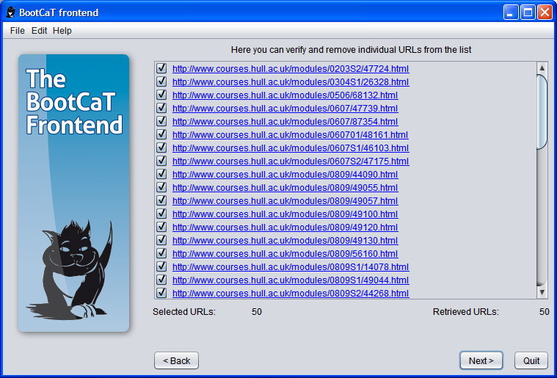
“Manual” corpus
BootCaT was used as a simple text downloader
tuples were replaced by the site: operator followed by a base-URL (e.g. site:university.ac.uk) and sent as queries to the Bing search engine
irrelevant URLs (if any) were discarded
Some statistics
“Manual” corpus
N. of university websites | 17
N. of URLs | 618
N. of tokens | 531,876

Slide 9
“Manual” corpus

Slide 10
Three methods for building genre-driven corpora
This phase includes
extraction of seeds from the manual corpus
which seeds?
keywords => e.g. “marks”, “students”
n-grams => e.g. “should be able”, “students will be”
“Different registers tend to rely on different sets of lexical bundles” (Biber et al., 2004, p. 377)

Slide 11
Three methods for building genre-driven corpora
This phase includes
extraction of seeds from the manual corpus
which seeds?
keywords => e.g. “marks”, “students”
n-grams => e.g. “should be able”, “students will be”
keywords & n-grams => “marks”, “students will be”

Slide 12
Three methods for building genre-driven corpora
This phase includes
extraction of seeds from the manual corpus
which seeds?
keywords => e.g. “marks”, “students”
n-grams => e.g. “should be able”, “students will be”
keywords & n-grams => “marks”, “students will be”
each group of seeds was used to build a corpus with BootCaT:
which one performs best?

Slide 13
Keyword extraction
AntConc (Anthony, 2004) was used for extracting keywords
Extraction procedure
the manual corpus was compared to a reference corpus (Europarl)
keywords were sorted by log‐likelihood score
the top 30 keywords were selected
“noise” was removed (“s”; “x”)
28 keywords remaining

Slide 14
Sample of keywords

Slide 15
n-gram extraction
AntConc used for extracting trigrams
Extraction procedure
n-gram settings
n-gram size: 3
min. frequency: 5
min. range: 5
the 30 most frequent trigrams were selected
“noise” was removed (“current url http”; “url http www”)
28 trigrams remaining

Slide 16
Sample of trigrams

Slide 17
Comparing parameters
Some statistics:
 | Corpus_key
Tuple length | 5
N. of tuples | 20
Max. n. of URLs for each tuple | 20
Domain restriction | ac.uk
 | Corpus_key
N. of URLs | 307
N. of tokens | 738,809

Slide 18
Comparing parameters
Some statistics:
 | Corpus_key | Corpus_tri
Tuple length | 5 | 3
N. of tuples | 20 | 20
Max. n. of URLs for each tuple | 20 | 20
Domain restriction | ac.uk | ac.uk
 | Corpus_key | Corpus_tri
N. of URLs | 307 | 325
N. of tokens | 738,809 | 546,478

Slide 19
Comparing parameters
Some statistics:
 | Corpus_key | Corpus_tri | Corpus_mix
Tuple length | 5 | 3 | 3
N. of tuples | 20 | 20 | 20
Max. n. of URLs for each tuple | 20 | 20 | 20
Domain restriction | ac.uk | ac.uk | ac.uk
 | Corpus_key | Corpus_tri | Corpus_mix
N. of URLs | 307 | 325 | 343
N. of tokens | 738,809 | 546,478 | 536,782

Slide 20
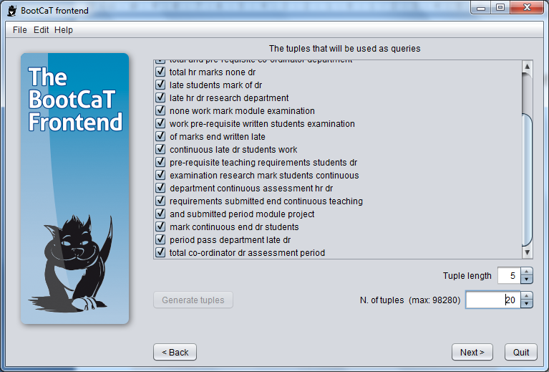
Tuples corpus_key

Slide 21
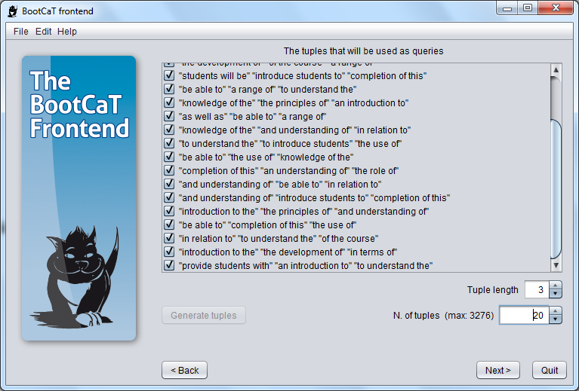
Tuples corpus_tri

Slide 22
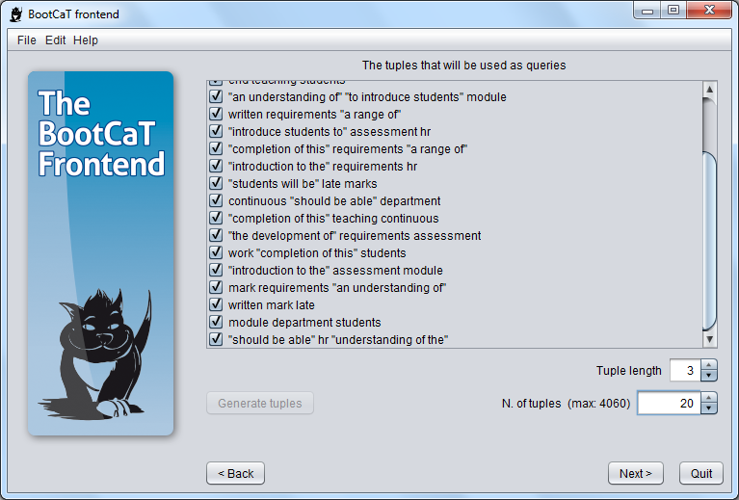
Tuples corpus_mix

Slide 23
Post hoc evaluation
Post hoc evaluation was mainly based on precision
100 URLs were randomly extracted from each corpus (ca.30%)
web pages were coded as “yes” or “no” depending on whether they hit or missed the target genre
Corpus_method | N. of relevant web pages (%)
Corpus_key | 21
Corpus_tri | 76
Corpus_mix | 65

Slide 24
Second try
Corpus_method | N. of tokens | N. of URLs | N. of relevant web pages (%)
Corpus_key (2) | 1,017,490 | 326 | 34
Corpus_tri (2) | 546,478 | 314 | 67
Corpus_mix (2) | 540,143 | 364 | 81

Slide 25
First try vs. second try

Slide 26
Summing up
Results showed that
the keyword method seems to be the least effective one for identifying genre
the mix method seems to need supervision
The trigram method seems to be the most effective and stable one for building genre-driven corpora semi-automatically

Slide 27
Back to the bigger picture
Studying institutional academic English
Providing language resources
A genre-driven corpus of academic course descriptions (ACDs)
A phraseological database, to assist writers/translators produce ACDs

Slide 28
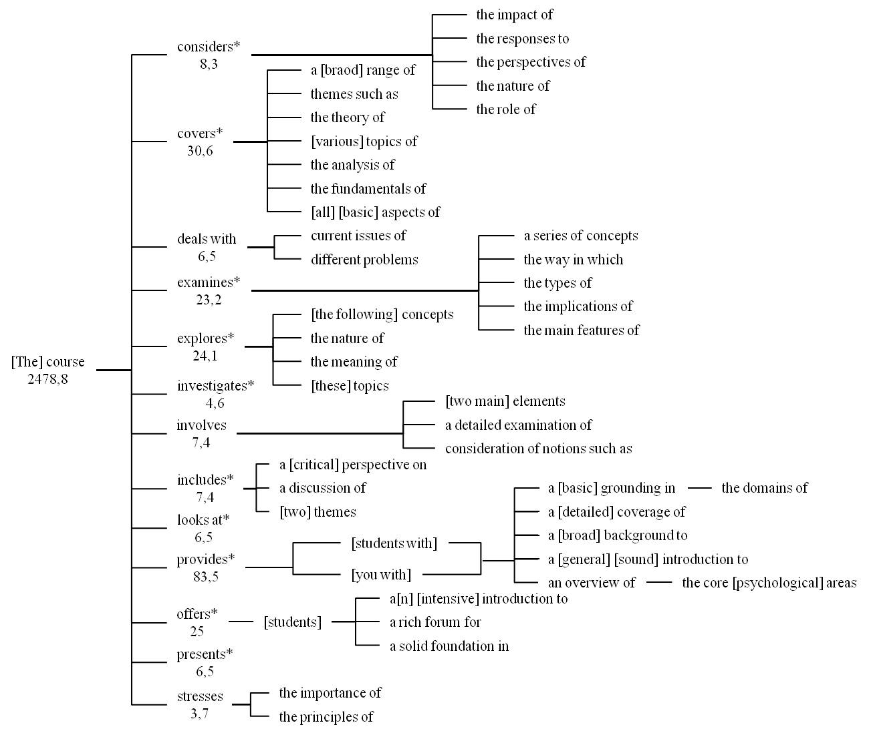

Slide 29
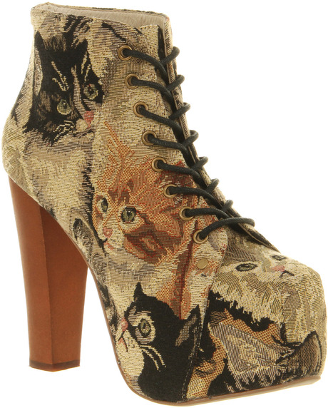
Same “topic” different “genres”

Slide 30
Genre-driven vs. Topic-driven BootCaT corpora: building and evaluating a corpus of academic course descriptions
THANK YOU
BOTWU BootCaTters of the world unite!
Erika Dalan (University of Bologna)

Slide 31
References
L. Anthony (2004) AntConc: A Learner and Classroom Friendly, Multi-Platform Corpus Analysis Toolkit. Proceedings of IWLeL 2004: An Interactive Workshop on Language e-Learning pp. 7–13.
M. Baroni and S. Bernardini (2004) BootCaT: Bootstrapping corpora and terms from the web. Proceedings of LREC 2004.
S. Bernardini and A. Ferraresi (forthcoming) Old needs, new solutions: Comparable corpora for language professionals. In Sharoff, S., R. Rapp, P. Zweigenbaum, P. Fung (eds.) BUCC: Building and using comparable corpora. Dordrecht: Springer.
E. Callahan and S.C. Herring (2012) Language choice on university websites: Longitudinal trends. International Journal of communication, 6, 322-355.
K. Crowston and B. H. Kwasnik (2004) A framework for creating a facetted classication for genres: Addressing issues of multidimensionality. Hawaii International Conference on System Sciences, 4.
D. Biber, S. Conrad and V. Cortes (2004). If you look at ...: Lexical Bundles in university teaching and textbooks. Applied Linguistics, 25(3), 371-405.
G. Rehm (2002) Towards Automatic Web Genre Identification: A corpus-based approach in the domain of academia by example of the academic's personal homepage. In Proceedings of the 35th Hawaii International Conference on System Sciences, 2002.
M. Santini (2004) State-of-the-art on automatic genre identification. Technical Report ITRI-04-03, ITRI, University of Brighton (UK).
M. Santini (2012) online: http://www.forum.santini.se/2012/02/beyond-topic-genre-and-search
M. Santini and S. Sharoff (2009) Web Genre Benchmark Under Construction. Journal for Language Technology and Computational Linguistics (JLCL) 25(1).

